Slide 1












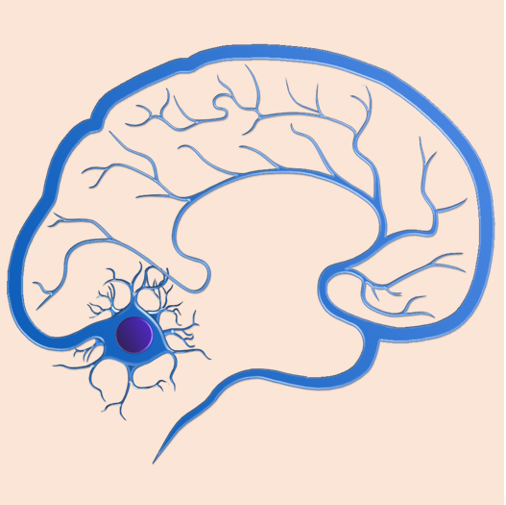











Addiction Medicine
Allergy & Immune
System Medicine
Anesthesiology
Behavioral Health
Cardiology
Dermatology
Ear, Nose & Throat (Otolaryngology)
Endocrinology
Emergency Medicine
Family Practice / Internal Medicine
Gastroenterology
Hematology
Neurology
Oncology
Ophthalmology /
Eye Care Medicine
Orthopedics
Pathology
Pediatrics
Podiatry
Pulmonology
Radiology &
Nuclear Medicine
Rheumatology
Surgery
Urology

